Slide 1
When all the Good Men are Gone: Sex Ratio and Domestic Violence in Post-Genocide Rwanda
Author: Giulia La Mattina
Presented by: Wenjie Zhao

Slide 2
Introduction of Rwanda genocide
April 6th 1994, President’s plane shot down
1994 April 6th to July 17th, a genocide took place
Around 100 days
800,000 of Rwanda’s Tutsi and politically moderate Hutu were killed
Year | 1990 | 1991 | 1992 | 1993 | 1994 | 1995 | 1996 | 1997
Population | 7.155 | 7.375 | 7.38 | 7.609 | 5.08 | 4.98 | 6.167 | 6.358
Percent change | 2.36% | 3.07% | 0.07% | 3.10% | -33.24% | -1.97% | 23.84% | 3.10%

Slide 3
Rwanda’s post-genocide marriage market
Genocide
Change in population structure
Marriage market affected

Slide 4
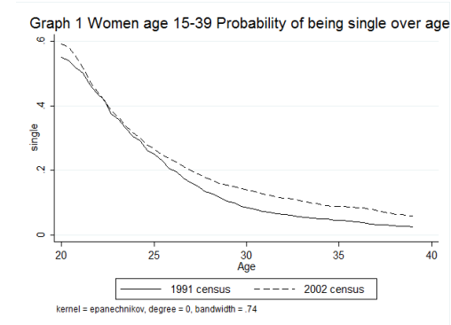
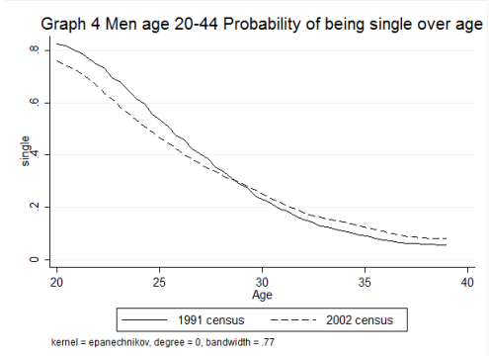
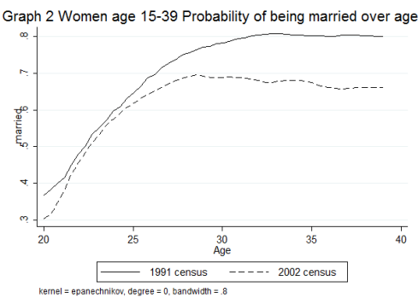
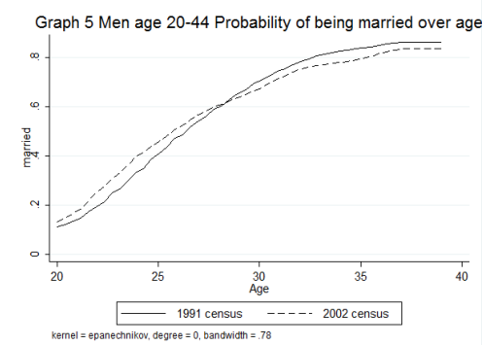
A simple comparison
Single women and men
Married women and men

Slide 5
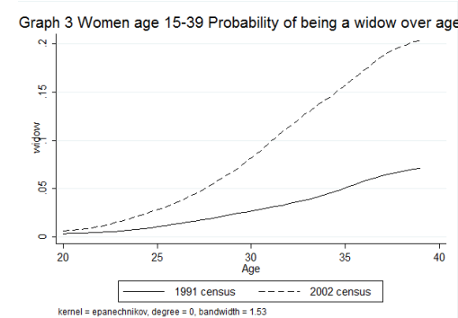
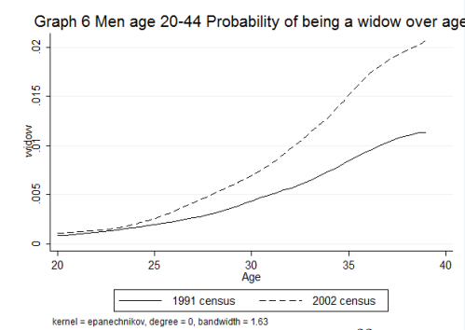
A simple comparison
Widow women and men
Older women suffered more: increase of single and widow women
Younger women were less affected
Younger women’s cohort less affected
Younger women were preferred for fertility
Marriage prospects improved for young men after the genocide

Slide 6
Theoretical framework
Marriage market
Woman: Imperfect information but knows the quality distribution of the potential husbands
Man: has a quality and probablity
q_{R}=f(q, λ, b)
q_{R:} women’s Reservation quality
q: average quality of the pool of potential husbands
λ: the arrival rate of marriage proposals
b: the value of being single

Slide 7
Prediction based on spousal search model
Scarcity of men | λ↓
Deterioration of the quality of men | q↓
Post-traumatic stress disorder for men
A decrease in the value of being single | b↓

Slide 8
Data – effects on match quality
Measurement of match quality
Domestic violence
Husbands’ education
Women’s decision making power
Model
Y_{i,p,t} = α+βSR_{p,1991}*(1-PG_{t})+βSR_{p,2002}*PG_{t}+γPG_{t}+δ_{p}+πX_{p,t}+σX_{i}+ υ_{c}+ԑ
Y_{i,p,t} : Measurement
δ_{p} : province dummy that captures time-invariant province-level factors such as local attitudes towards women and legal enforcement
SR_{p,t} : province-level sex ratio; regressor of interest
X_{p,t} : province-level controls
X_{i} : household-level controls

Slide 9
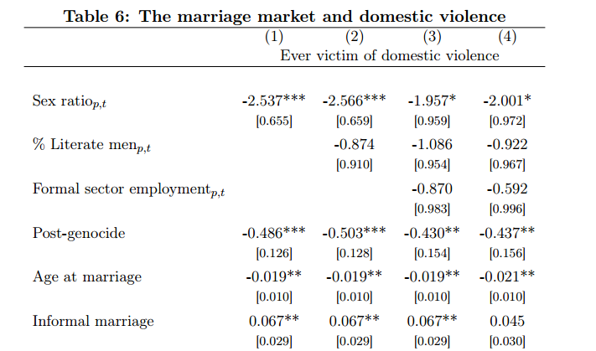
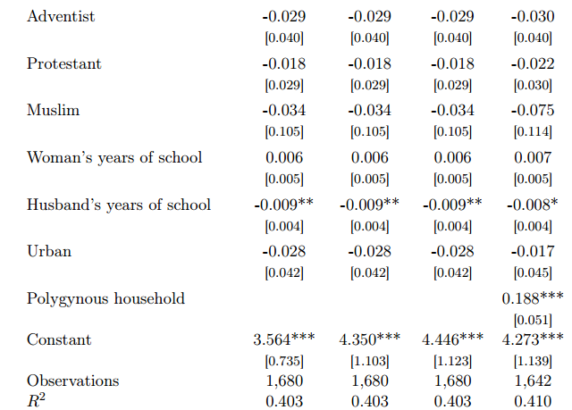
Dependent variable: Probability that a woman becomes a domestic violence victim

Slide 10
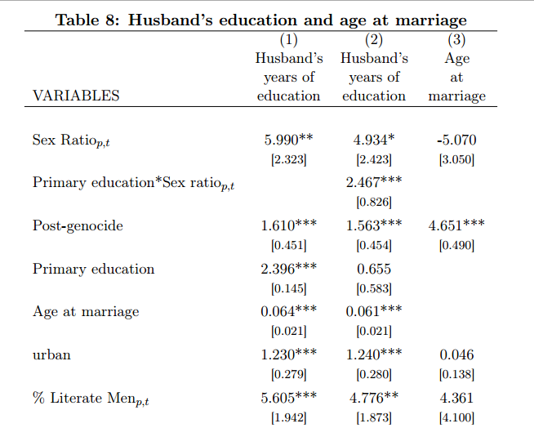
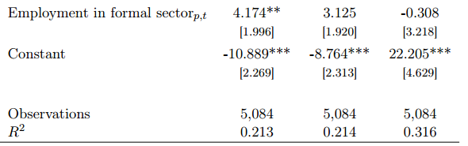
Dependent variable: husbands’ education attainment and age at marriage

Slide 11
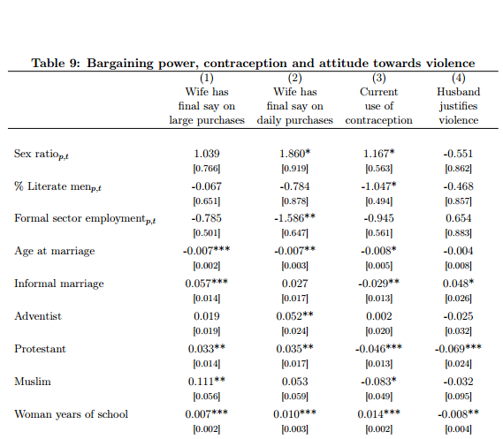
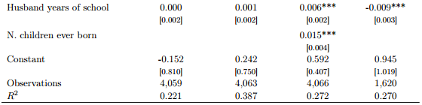
Dependent variable: women's bargaining power, contraception and attitude towards violence

Slide 12
Conclusions
Women who married after the genocide in provinces where the sex ratio decreased more were more likely to become victims of intimate partner violence.
Women who married after the genocide in provinces where men were scarcer married men with lower educational attainment on average.
In addition, the decrease in the sex ratio left women with less decision-making power within the household.

